Slide 1
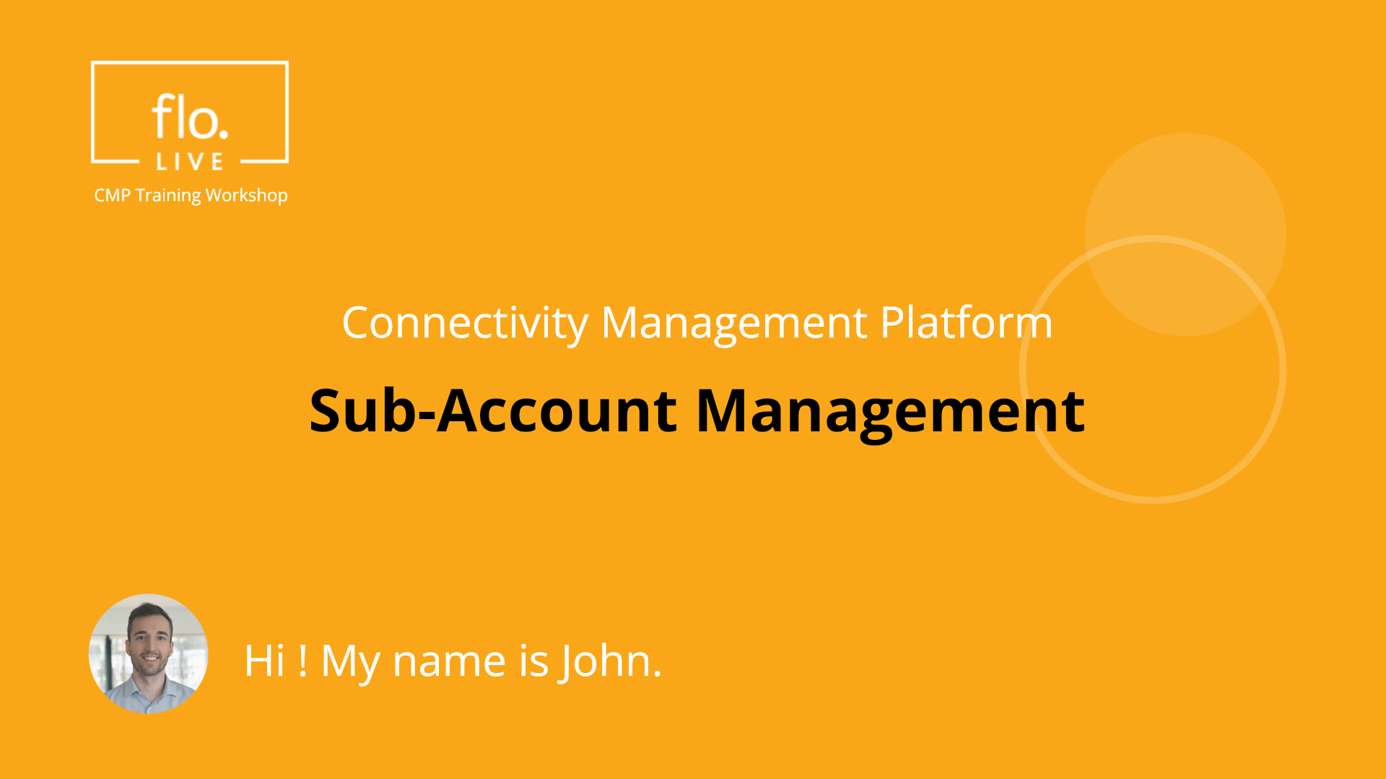
Notes:
Hi. My name is John and welcome to the CMP Training Workshop

Slide 2
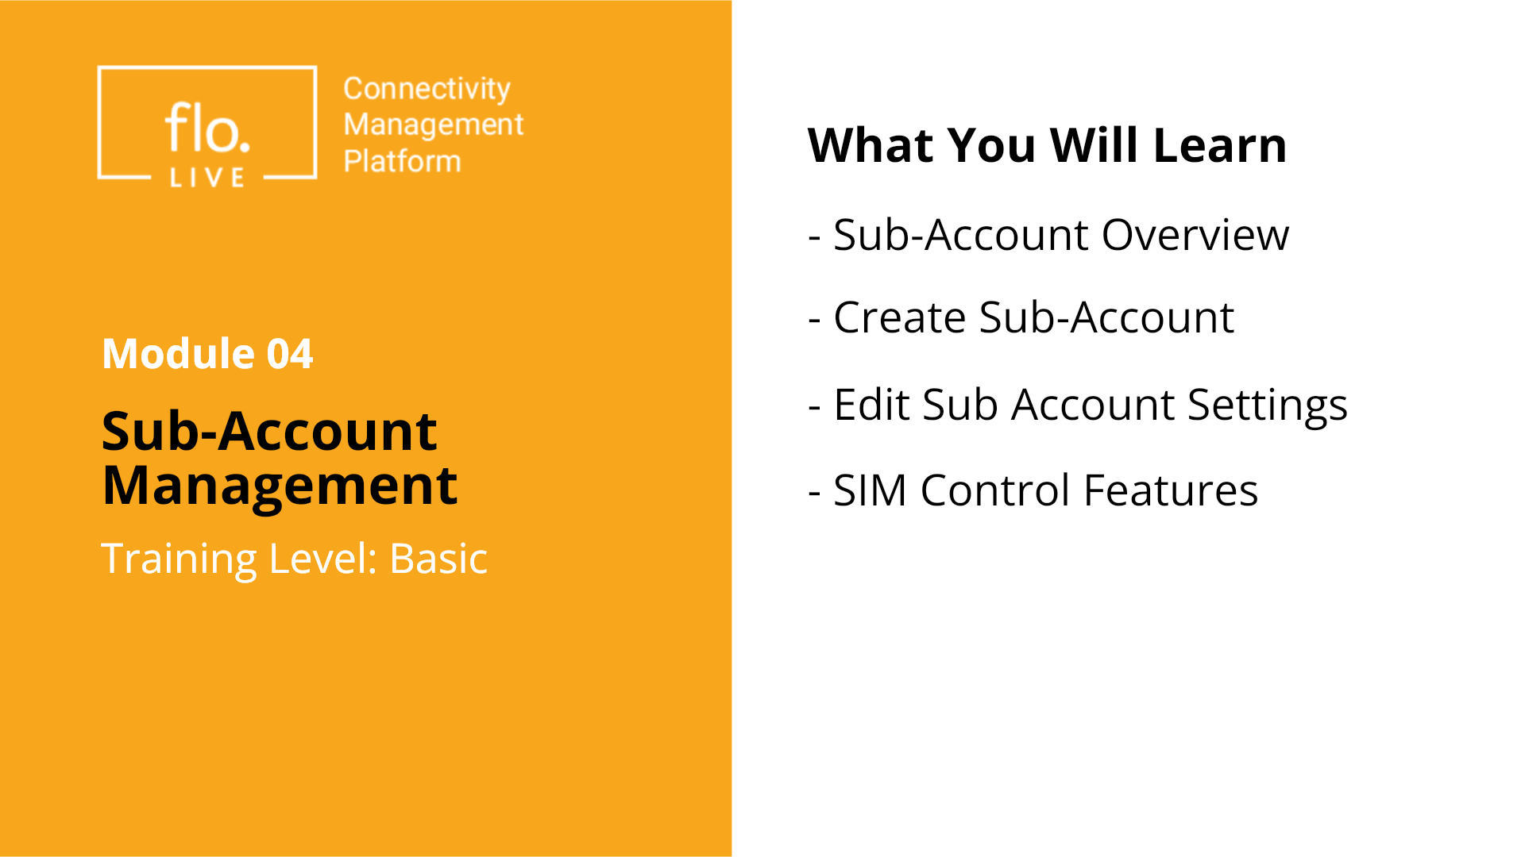
Notes:
In this tutorial, we explore the sub-account management module. We begin with an overview of the key features Then you will learn how to create, and edit your sub-account data. Finally, we will learn how to enable customers to access, and manage their SIM cards.

Slide 3
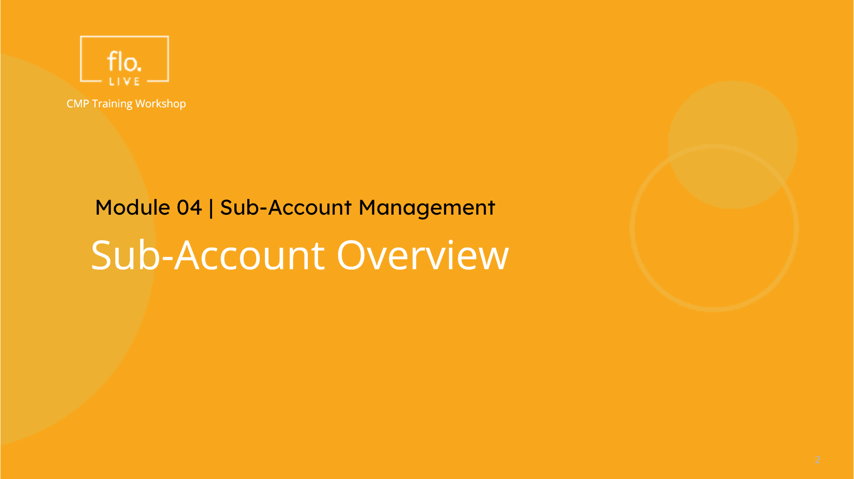
Notes:
We begin this tutorial with a quick tour of the Sub Account details section.

Slide 4
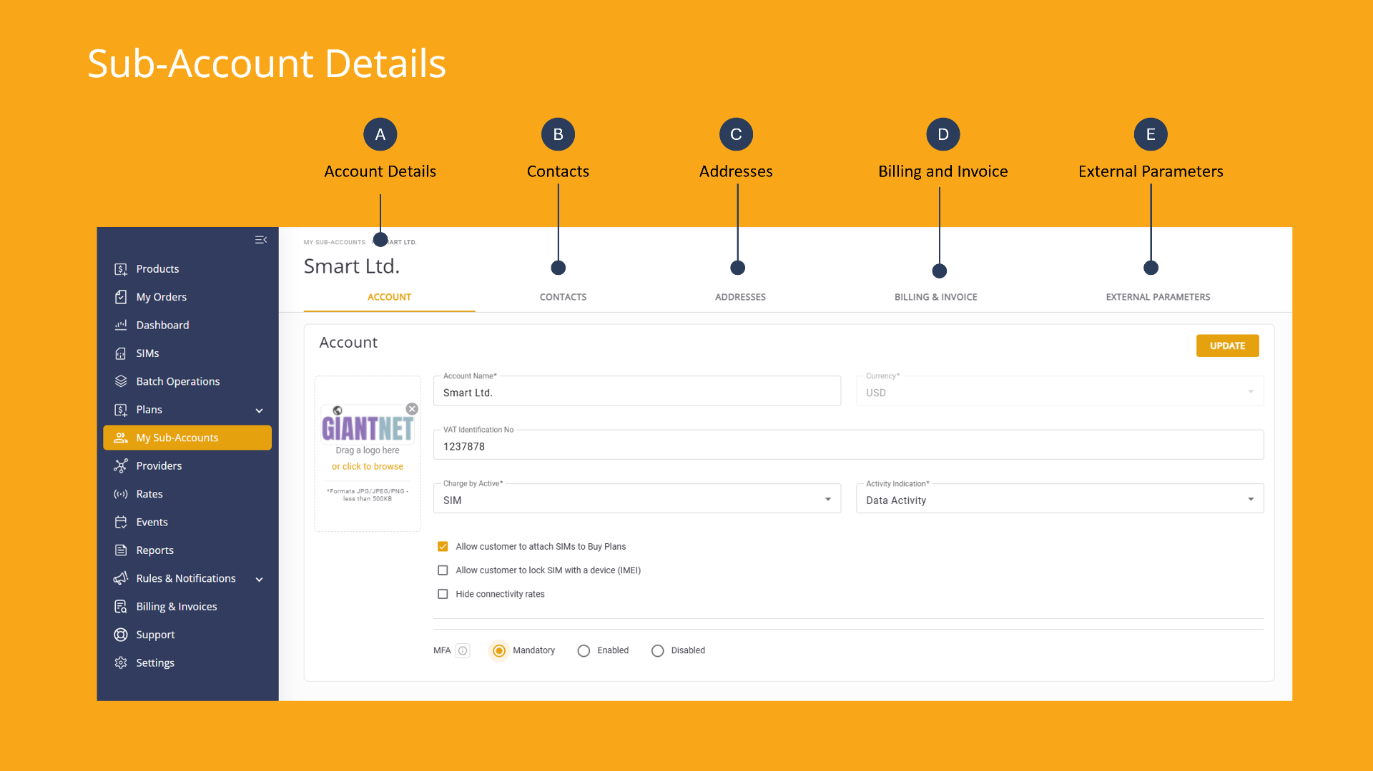
Notes:
When you access the default page, an overview of the sub-account information is displayed. / / / / / / The Contacts tab lets you manage associated contact people. / / In the Addresses tab, you can specify the business or shipping address. / / The Billing and Invoice tabs enables you to define the billing cycle andconfigure the invoice settings. Finallly / // / the external parameters tab enables you to associate external data to your sub-account.

Slide 5
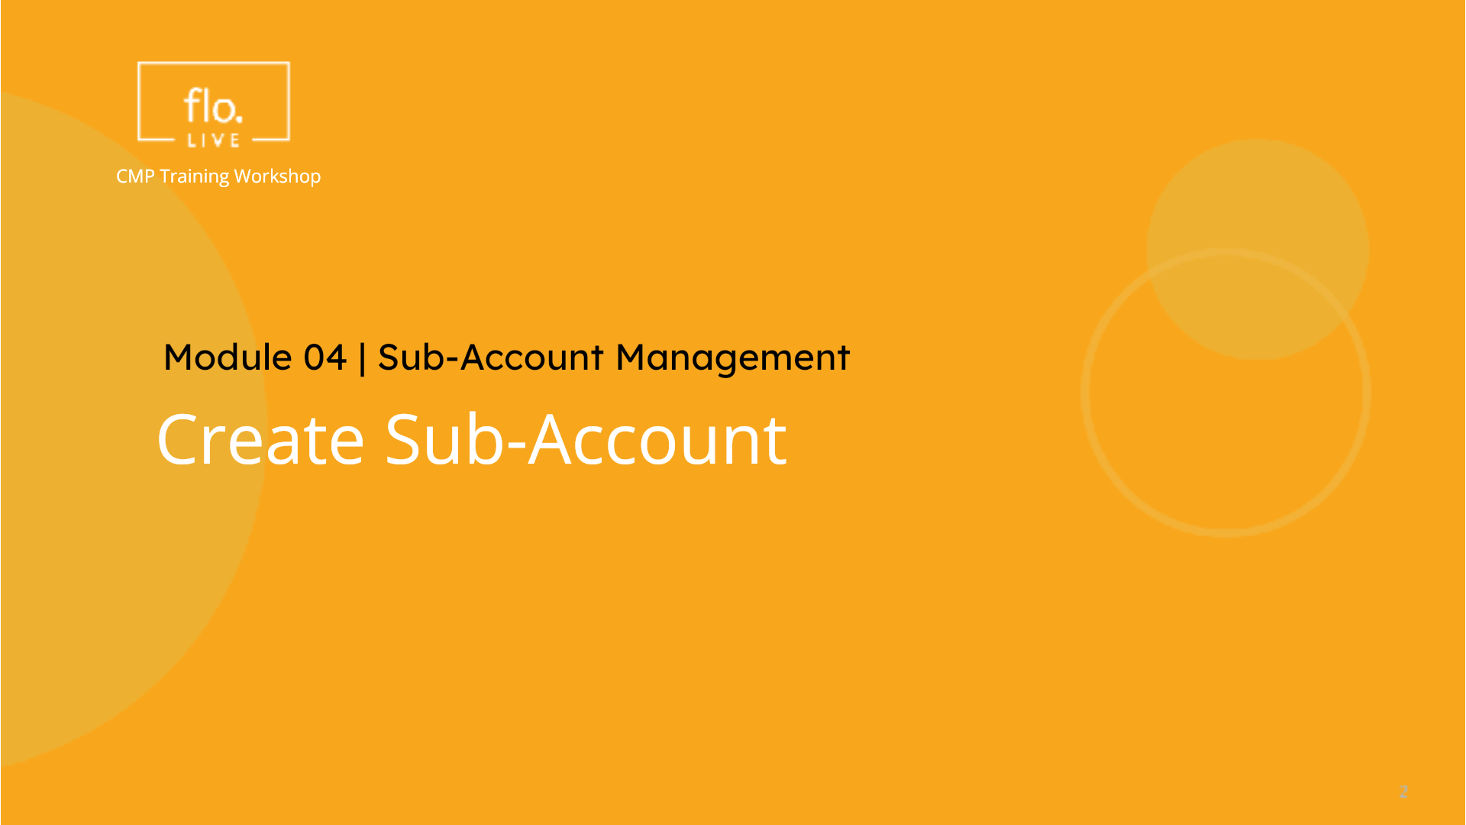
Notes:
Lets create a new sub-account.

Slide 6
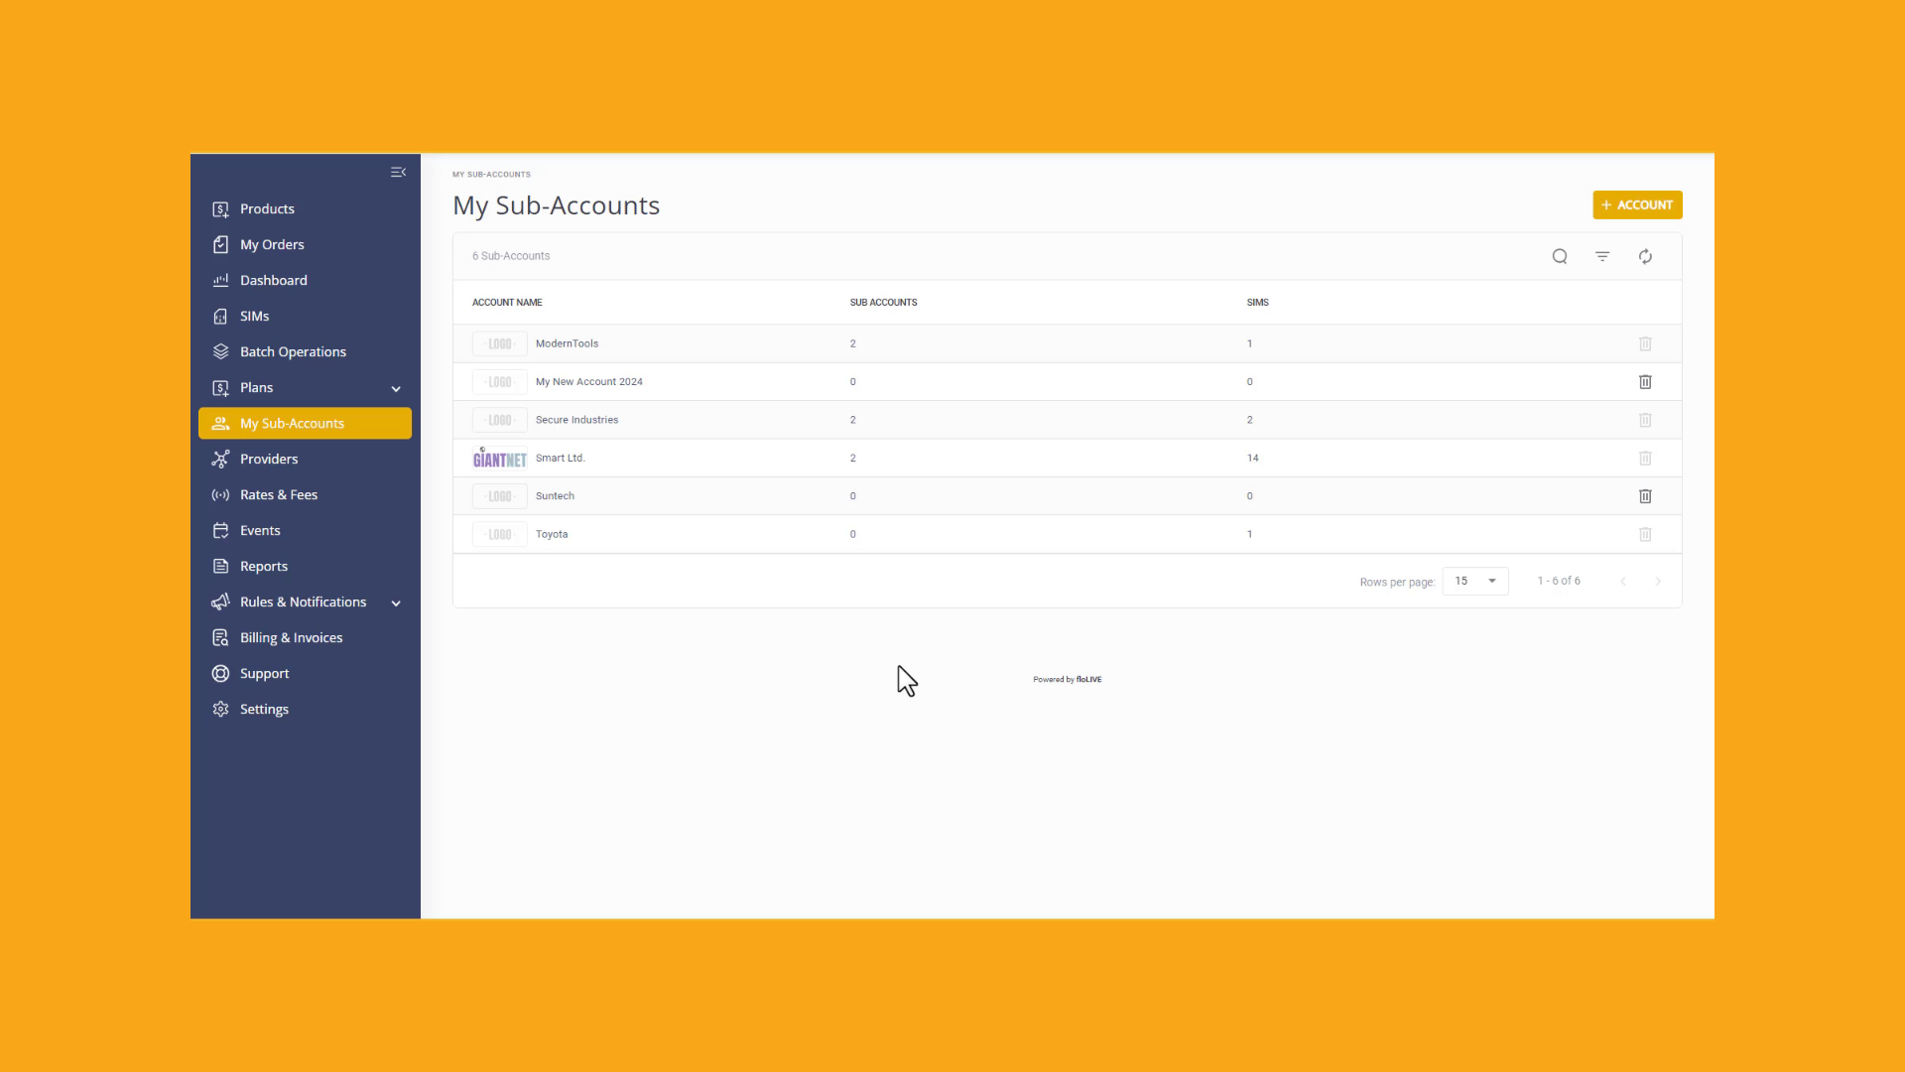
Notes:
Go to the sidebar menu and click "My Sub Accounts". A list of existing sub-accounts is displayed in a table. . Now go to the top of the page and click the "Add Account" button. /The "New Account" dialog box is displayed. Enter a name for your new sub-account. Notice that this field is mandatory. You must also select the currency associated with your sub-account transactions. . Enter the VAT Identification Number of your sub-account. . You should note that each sub-account requires that you define a Billing Cycle setting. You can also specify a List of Eligible Billing Cycles associated with the sub-account and allow customers to attach SIMS to buy plans. Click the Save button to update the system. A Success notification message is displayed when your sub-account is created.

Slide 7
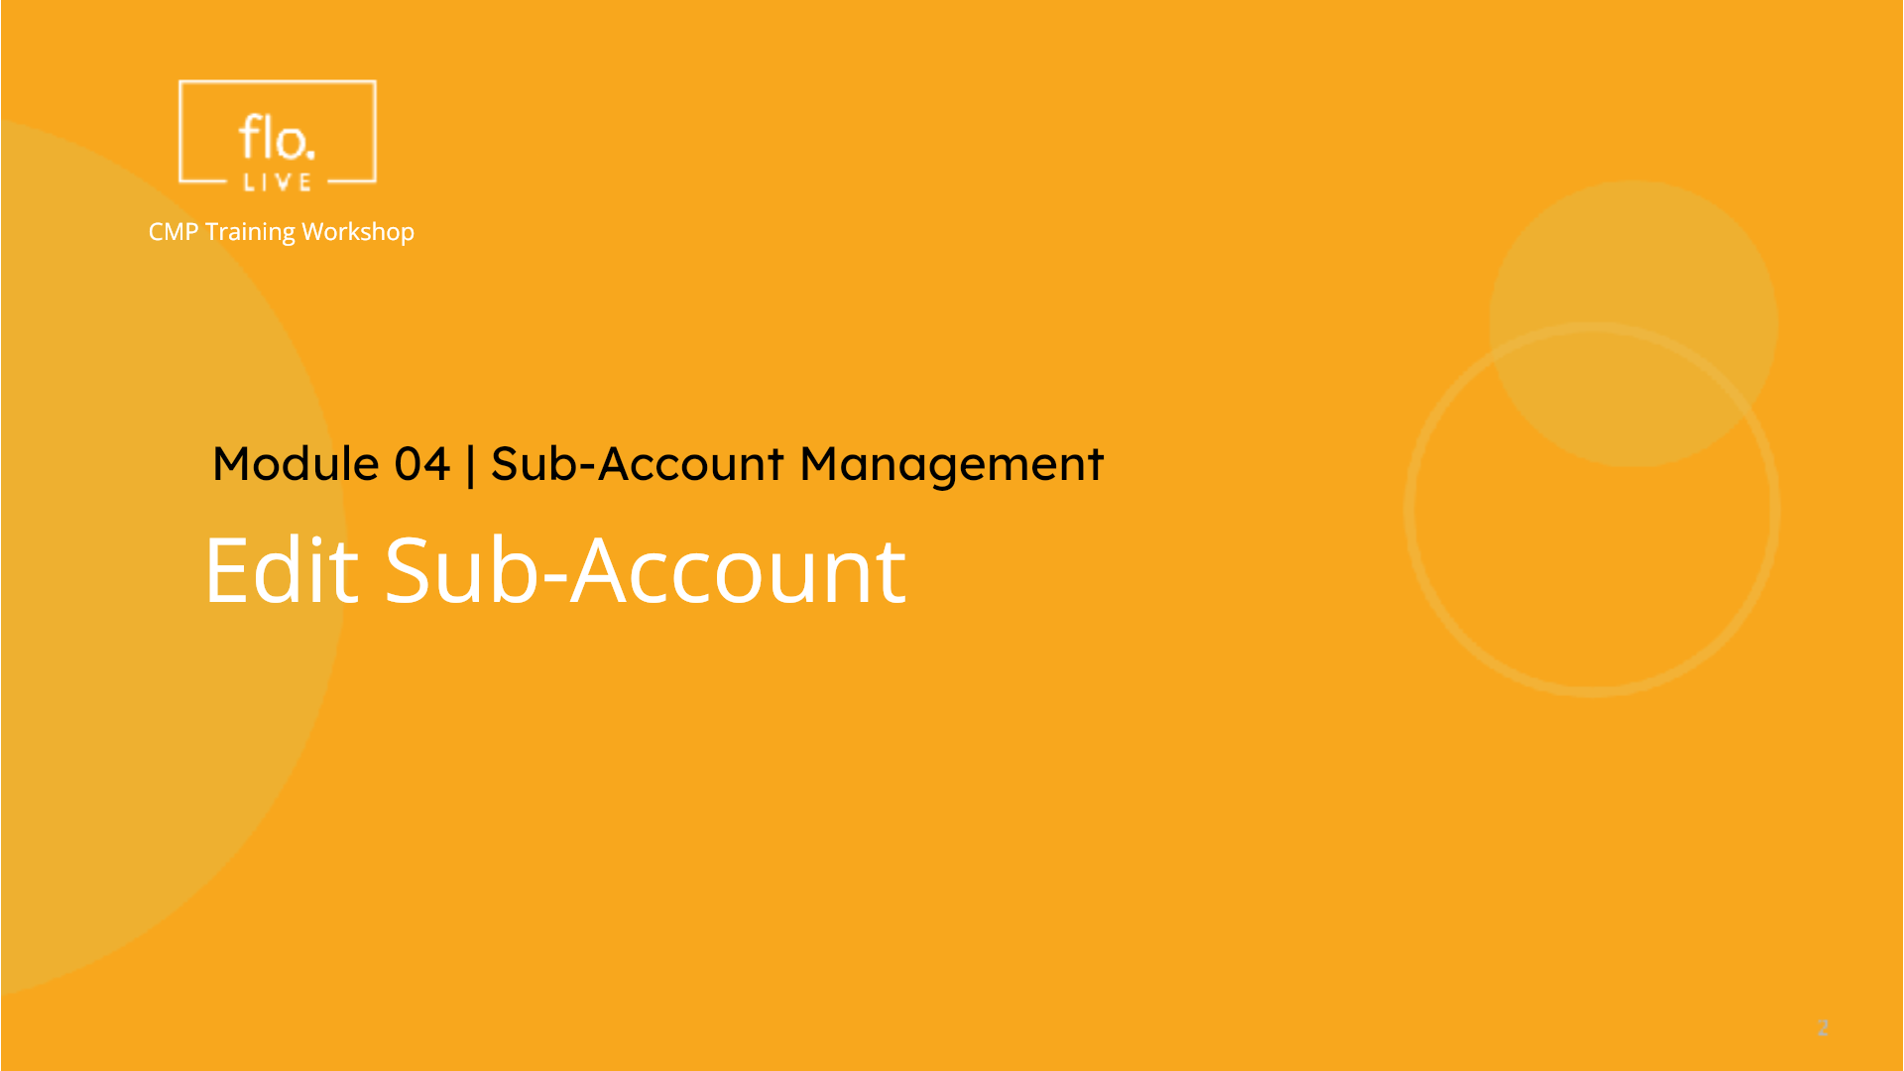
Notes:
Now we take a look at the settings for an existing account.

Slide 8
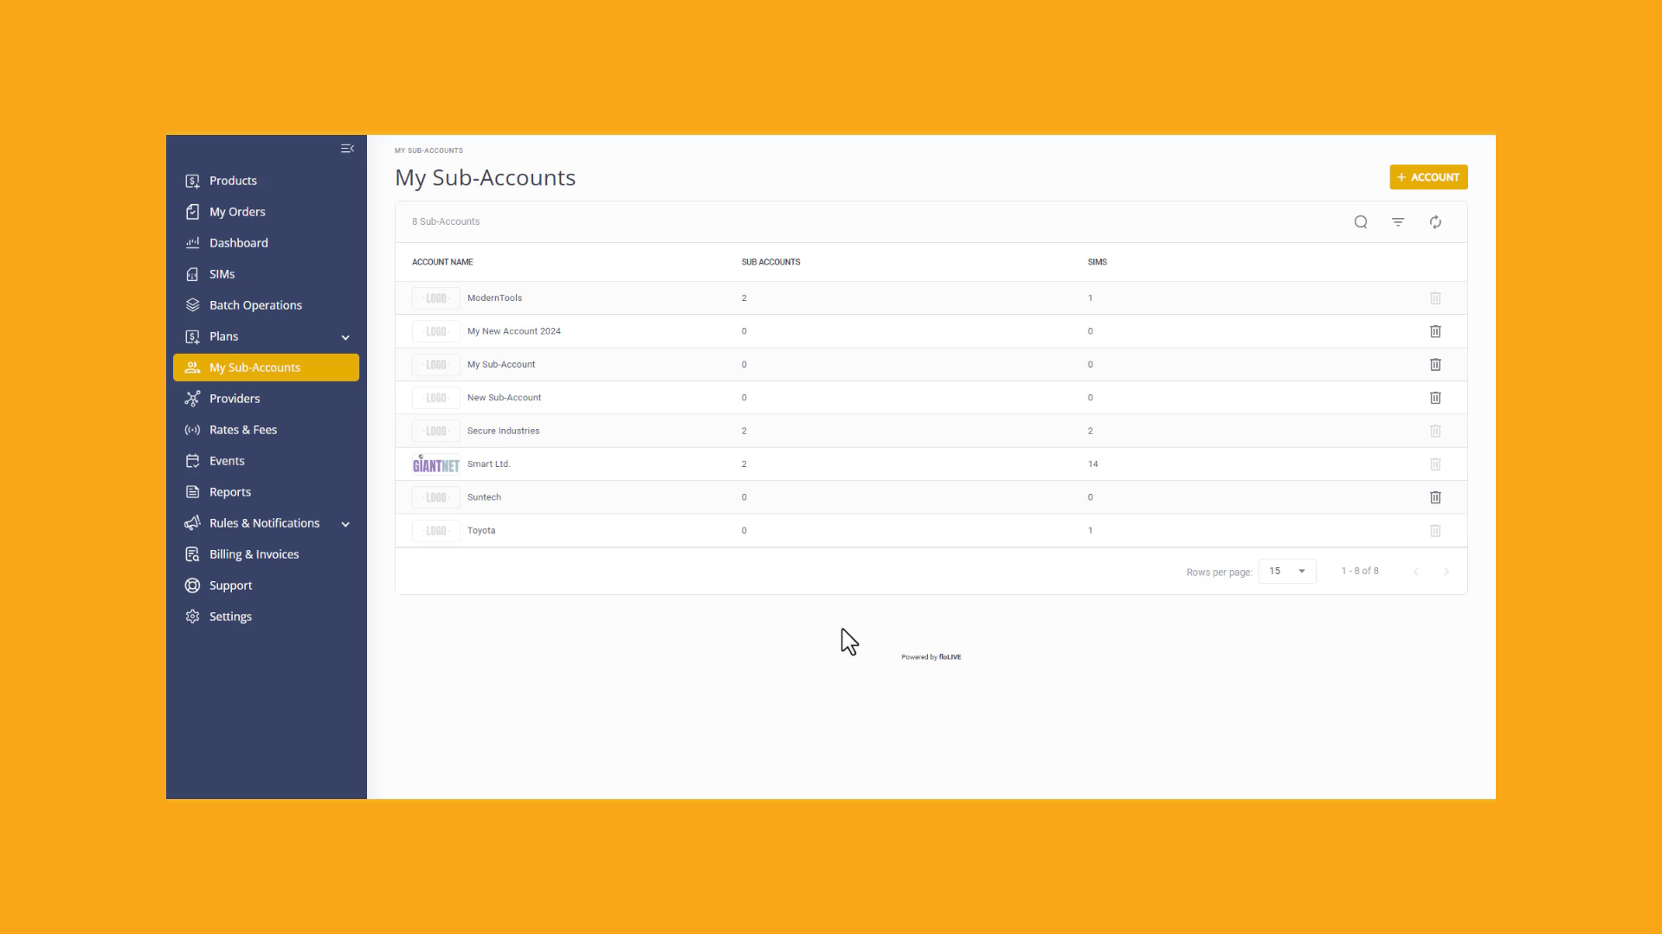
Notes:
Click a sub-account to display the details page. . In the Account tab you can edit the Account Name, the VAT ID number, and various other account parameters. . Remember, when you complete your changes you need to click the Update button to save your changes. Now lets update the Sub-Account Contact details. For each contact listed in the table, there is an Action menu. Select the Edit option and update the contact information. . To update the business or shipping address, go to the the Address tab and again, select the Edit option in the Actions menu. You can access the Billing and Invoice tab to edit the Billing Cycle parameters and the Invoice Configration settings. Finally, , go to the External Parameters tab when you need to update the list of associated sub-account parameters.

Slide 9
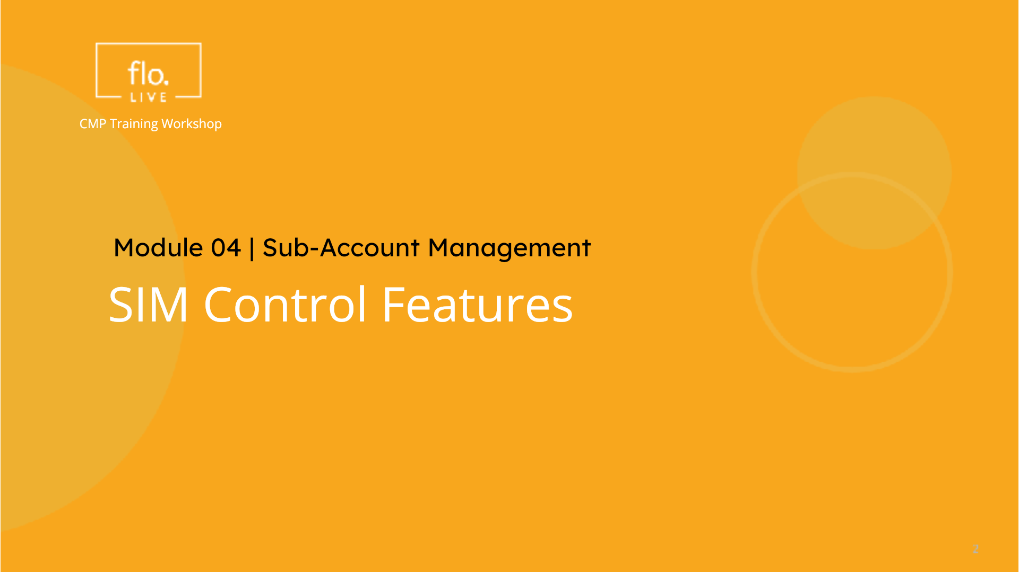
Notes:
To complete this tutorial I will show you how to enable customers to access, and manage their SIM cards.

Slide 10
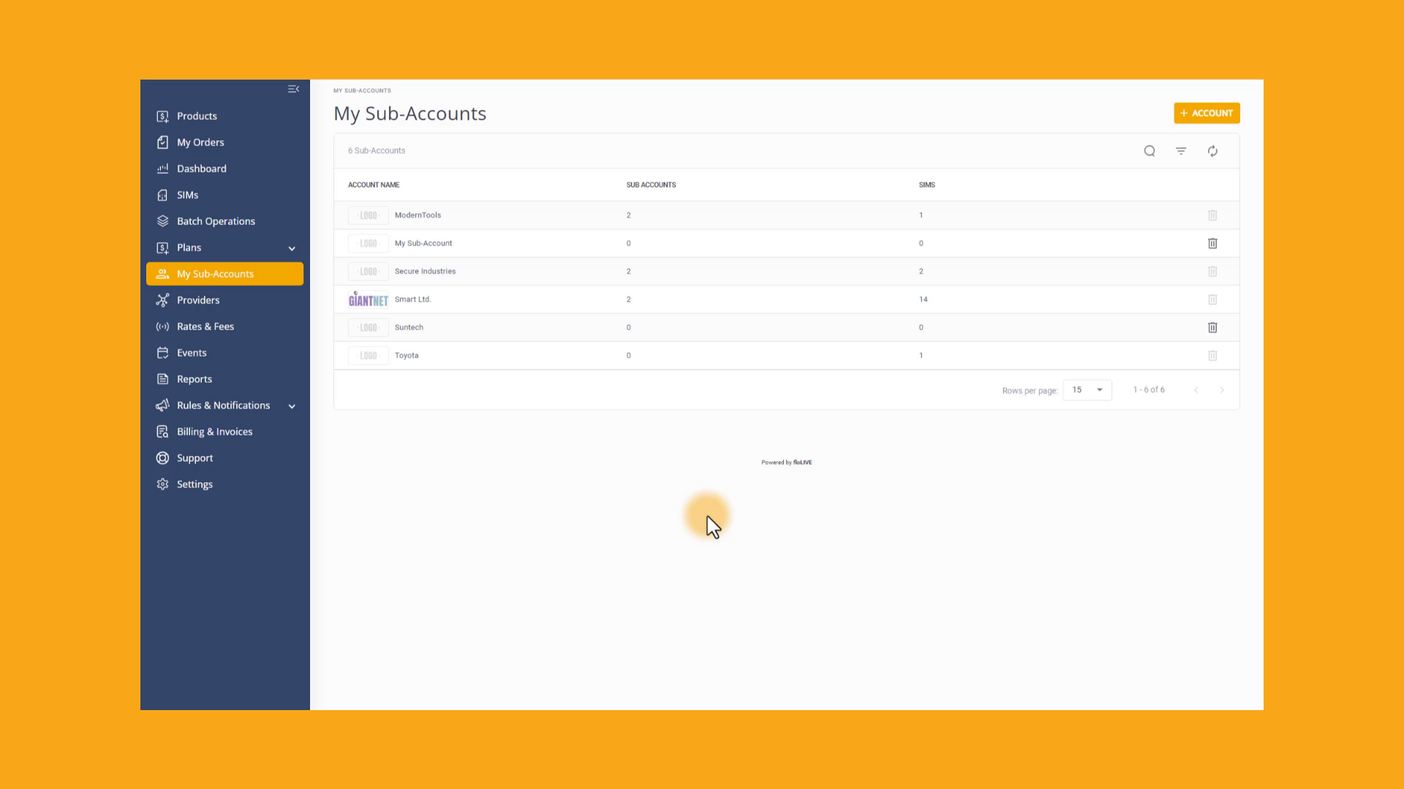
Notes:
When you create a new sub-account, pay attention to these three features. First, you can Allow customers to attach a SIM card to a Buy-Plan. This enables customers to link their SIM cards to specific purchasing plans for billing purposes. . Second, you can Allow customers to lock a SIM with a specific device, to prevent unauthorized usage. The third option, enables you can Hide the connectivity rates. This feature allows you to conceal pricing of connectivity plans for privacy or commercial reasons. These SIM Control features can be updated when you access the Sub-Account details page.

Slide 11

Notes:
Thank you for watching this video tutorial. For more information about the CMP system, make sure you visit our Knowledge-base that is accessible directly from the CMP Portal.

